Slide 1
Cryptocurrencies A Socialogical Approach
Jordan Ong Zhi Rong
Kenneth Low Yan Wei
Peace Tay Jiunn Ching
Tan Yu Yan, Rachel
Widya Tantiya Yutika
Yap Pin Yaw

Slide 2
Hypothesis
“Prices of cryptocurrencies have a strong correlation with the sentiments of certain individuals, institutions or the general population”

Slide 3
Objectives
1
To explore if sentiments on social media have a correlation with crypto prices
To analyse the extent of influence selected individual/Institutions have on crypto prices based on centrality score
2
3
To gain insights on the topics on social media during days of large price movements

Slide 4
Table of Contents
01
02
03
04
05
Datasets
Network Visualisation
& Centrality Analysis
Sentiment Analysis
Topic Modelling
Conclusion

Slide 5
01
Dataset

Slide 6

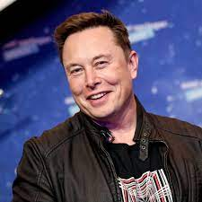
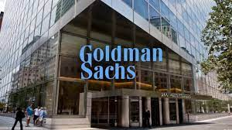
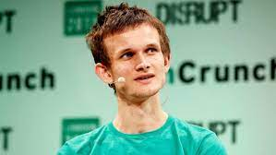

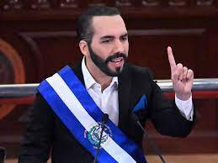




Data Sets
Tweets (Influencers)
Tweets (Institutes)
Founder of Tesla, SpaceX
Richest man in the world
Known to influence price in the market
Leading global investment bank and financial services company
Widely followed by institutional and retail investors and market participants
Elon Musk
Delivers business and market news
Also widely followed by institutional and retail investors and market participants
Co-founder of Ethereum
Strong advocate for creating decentralized money
Vitalik Buterin
President of El Salvador
First country in the world to adopt cryptocurrency as legal tender
Tweets (General Pop)
Forum Discussions
In 2019, around 18k bitcoin related tweets per day
In recent years, as bitcoin gains more popularity, around 100k+ bitcoin related tweets per day
Online social forum for discussion
Bitcoin subreddit has 4,300,000 members with average of 3,600 active online
Data of posts in the subreddit
Nayib Bukele
Founder and CEO of Binance
World largest cryptocurrency exchange by trading volume
Changpeng Zhao
Notes:
Intro & Dataset by Pin Yaw

Slide 7
02
Network Visualisation & Centrality Analysis

Slide 8
Total Number of Nodes ~ 180,000
Elon Musk
~ 30,000
Follower nodes
5,000 from
each user
~ 180,000
Follower nodes
Top 10% ~ 30
(users with most followers)
Changpeng Zhao
Vitalik Buterin
5,000 from
each user
Nayib Bukele
Bloomberg
Goldman Sachs

Slide 9
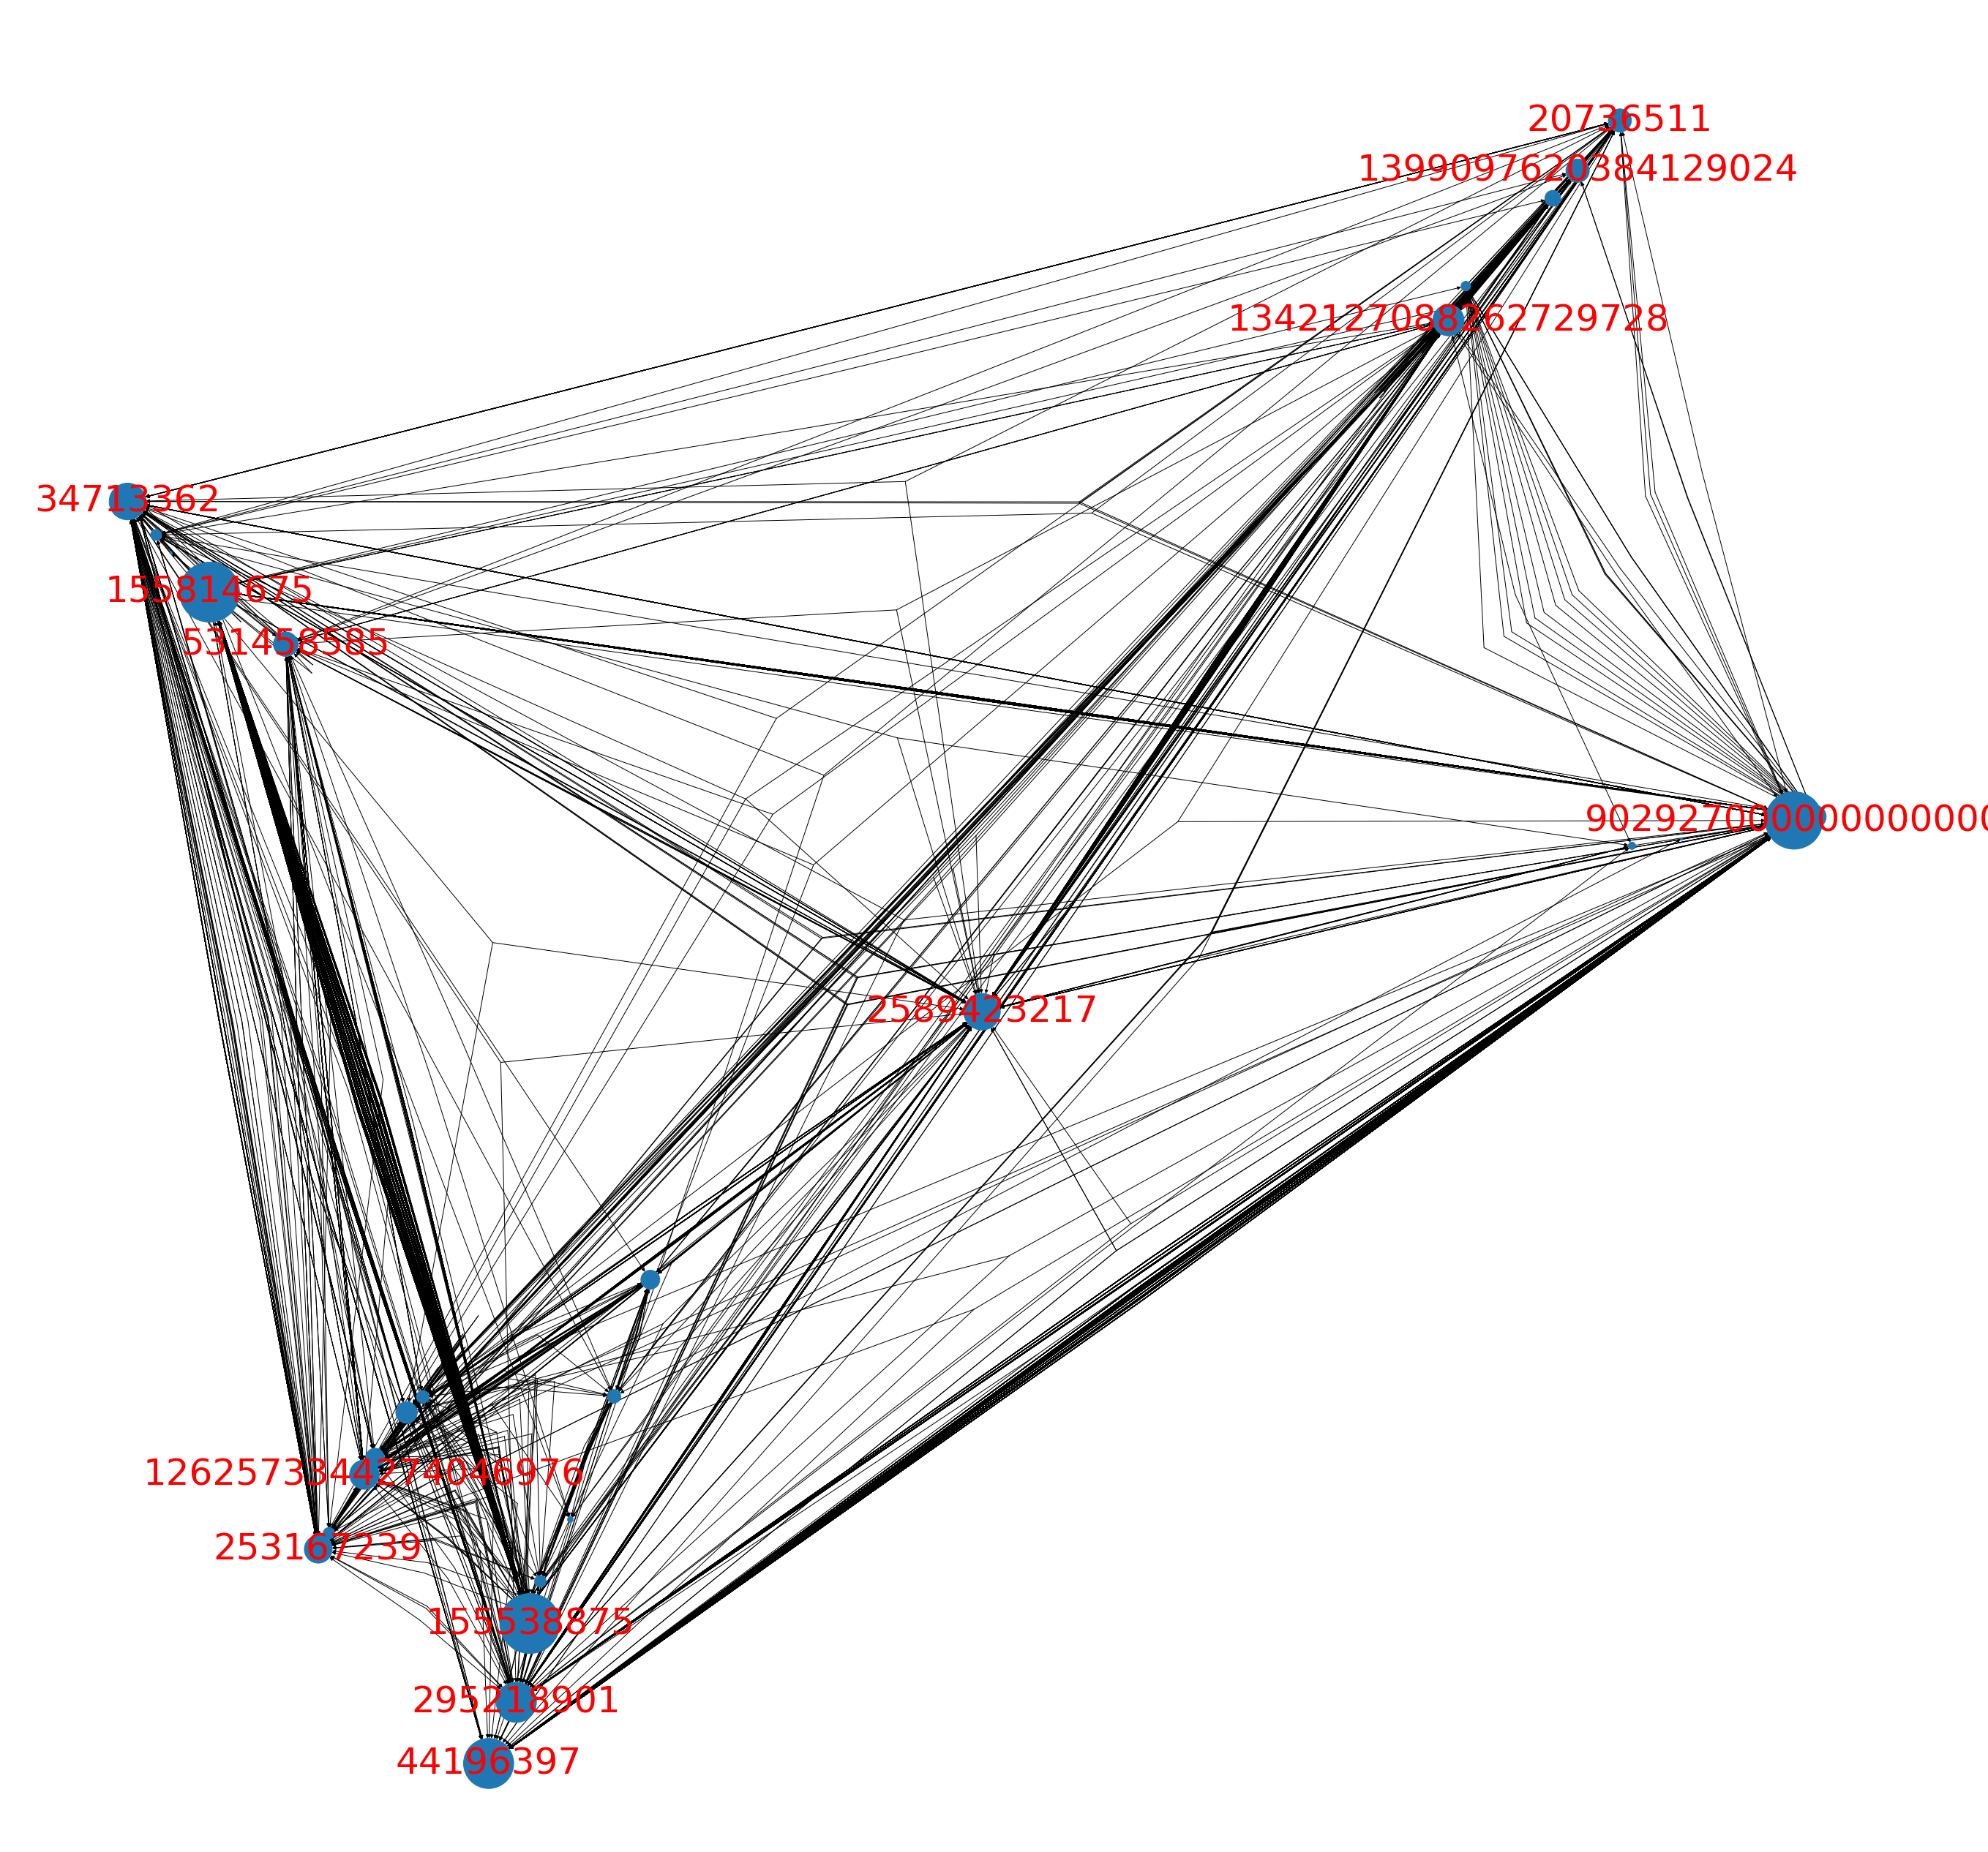
Network Visualisation
Level 0
Level 1
Level 2
Results
4 influencer + 2 institutes
5000 followers from each Level 0 users
5000 followers from each of the top 10% Level 1 users
Network Diagram of ~180,000 nodes, removing nodes with <2 degrees
Network Graph Visualisation
In-Degrees of Nodes
Simplified network graph by removing nodes with <2 degrees
Influencers: Institutions:
Notable Others:
Followers of 6 selected influencers + institutes tend to follow other accounts with similar focus.
Nayib Bukele
Elon Musk | 470
Changpeng Zhao | 616
Vitalik Buterin | 302
Nayib Bukele | 100
Bloomberg | 252
Goldman Sachs | 144
JoseAMtnzRivera
Brass_Statement
Bloomberg
Changpeng Zhao
DontezAkram
Brass_Statement | Defi payment network | 182
JoseAMtnzRivera | Co-founder of XoloToken | 102
Dontez Akram | Entrepreneur | 112
Victor_eth0x | Cryptocurrency promoter | 671
AltcoinWorldcom | Altcoins promoter | 251
cdntradegrljenn | Equity Investor | 162
AltcoinWorldcom
cdntradegrljenn
Observation:
Goldman Sachs
Vitalik Buterin
Victor_eth0x
Elon Musk
Notes:
globalonemedia_ (673)
LaTerribleLiz (100)
ADD IN LIMITATION (5000 SAMPLE SIZE)
No effect on accuracy / precision
Peace – Centrality Analysis

Slide 10
Network Centrality Analysis
Level 0
Level 1
Level 2
Results
4 influencer + 2 institutes
5000 followers from each Level 0 users
5000 followers from each of the top 10% Level 1 users
PageRank is calculated based on a ~180,000-node network
PageRank Scoring
No. of Followers
Influencers: Institutions:
High follower count ≠ High PageRank Score
Retail investors & speculators follow influencer accounts such as Elon Musk → Lower PageRank Score
Finance professionals follow news channels and Financial Institutes such as Bloomberg and Goldman Sachs → Higher PageRank score
Elon Musk | ~ 98,000,000
Changpeng Zhao | ~ 6,400,000
Vitalik Buterin | ~ 4,000,000
Nayib Bukele | ~ 4,000,000
Bloomberg | ~ 8,300,000
Goldman Sachs | ~ 937,700
Observation:
Influencers
Institutions
Size = # of followers
Notes:
ADD IN LIMITATION (5000 SAMPLE SIZE)
No effect on accuracy / precision
Peace – Centrality Analysis

Slide 11
03
Sentiment Analysis
Notes:
Sentiment Analysis – Rachel & Kenneth

Slide 12

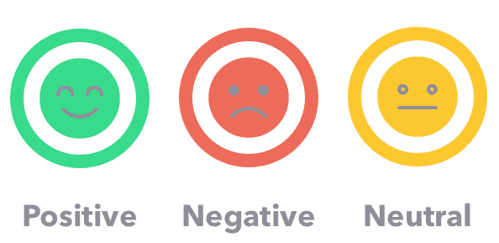
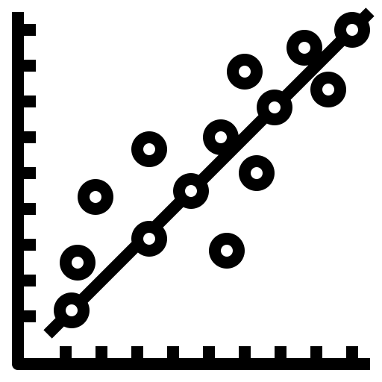





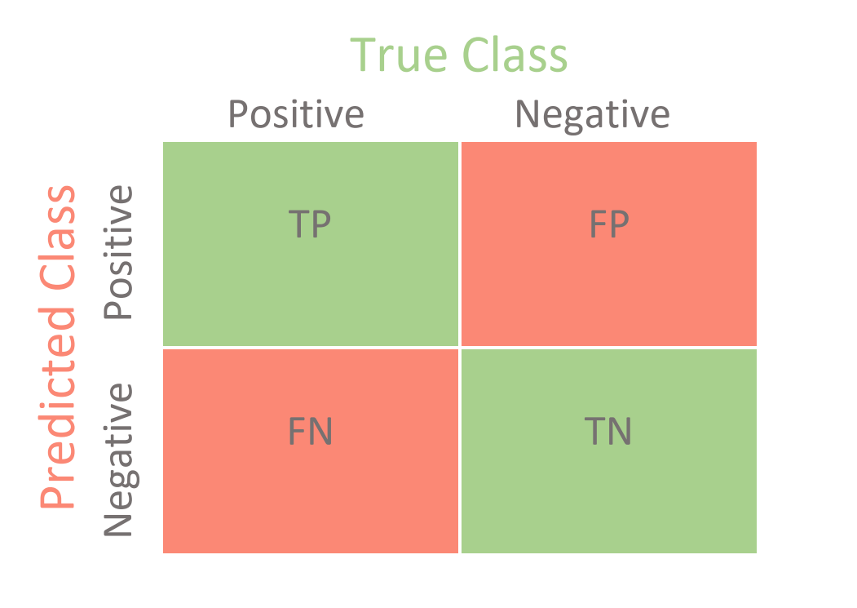

Step by Step Process of Analysis
Extracting Data
Pre-Processing
Sentiment Analysis
Results
Twitter API
Python Library: Snscrape
Emoji Handler
Compound Score
Pushshift Reddit API
Language Detect: English
Stop Words Removal

Slide 13
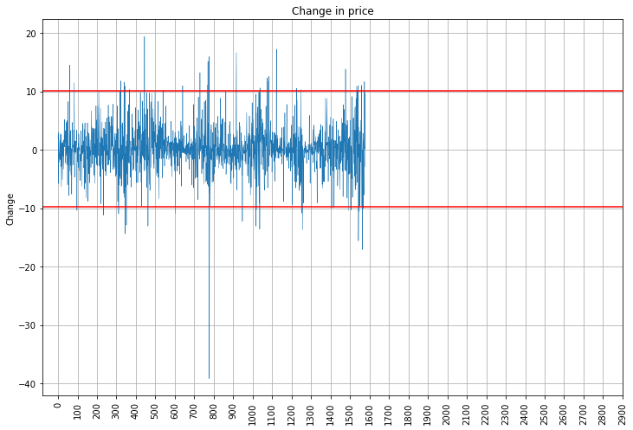
Price Fluctuations
Bitcoin
Any positive % change increase = Price Rise
Positive % change > 2.5 SD = Price Hike
Hike
Rise
Bitcoin
Drop
Any negative % change increase = Price Drop
Negative % change > 2.5 SD = Price Dip
Dip
+-2.5 standard deviation from the mean [+10% / -9.8%]
27 days with large increase in price, 24 days with large decrease in price

Slide 14
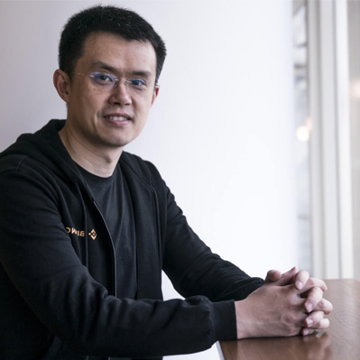
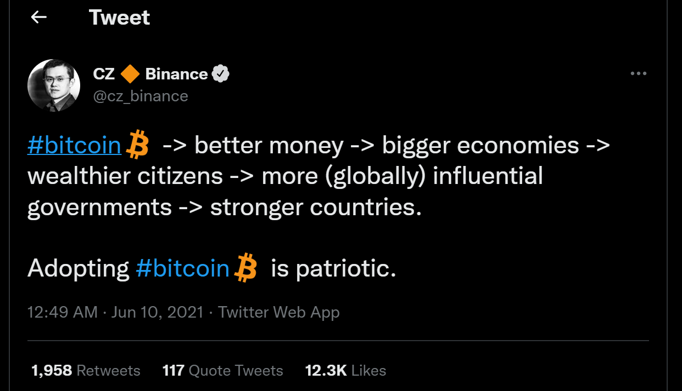
On 9th June Changpeng Zhao Tweeted
Bitcoin price increased by 11.83%
Compound score of 0.89
^time shown here is Singapore time

Slide 15
Main idea!
Price Hike/Dip Days
Extract crypto related tweets on those days
Compound score
Price hike/rise days should have positive compound score
Price dip/drop days should have negative compound score
Price Rise/Drop Days
Extract tweets on those days

Slide 16
Influence Scoring (Computation)
 | Actual Label = 0 (Price Dip/Drop) | Actual Label = 1 (Price Hike/Rise)
Predicted Class = 0 (-ve Compound Score) | True Neg (TN) | False Neg (FN)
Predicted Class = 1 (+ve Compound Score) | False Pos (FP) | True Pos (TP)
Individual analysis of each influencer’s tweet on days of price hike/dip with their relative compound score (+ve or –ve).

Slide 17
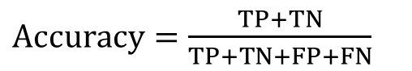
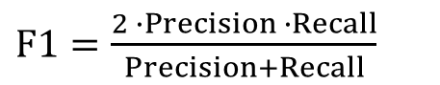
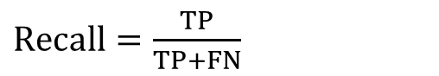
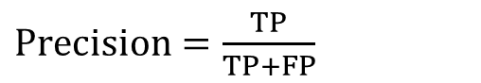
Influence Scoring (Bitcoin – Hike/Dip)
 | Actual Label = 0 (Price Dip/Drop) | Actual Label = 1 (Price Hike/Rise)
Predicted Class = 0 (-ve Compound Score) | True Neg (TN) | False Neg (FN)
Predicted Class = 1 (+ve Compound Score) | False Pos (FP) | True Pos (TP)
$Accuracy=\frac{TP+TN}{TP+TN+FP+FN}$
$Precision=\frac{TP}{TP+FP}$
$F1=\frac{2 ∙Precision ∙Recall}{Precision+Recall}$
$Recall=\frac{TP}{TP+FN}$
 | Elon Musk |  | Nayib Bukele |  | Vitalik Buterin |  | Changpeng Zhao |  | Goldman Sachs |  | Bloomberg
Accuracy | 0.73 | 0.5 | 0.6 | 0.545 | 0.615 | 0.536 | 0.647 | 0.576 | 0.5 | 0.544 | 0.464 | 0.504
Precision | 0.833 | 0.537 | 0.6 | 0.55 | 0.769 | 0.555 | 0.692 | 0.531 | 0.5 | 0.552 | 0.466 | 0.524
Recall | 0.833 | 0.663 | 1* | 0.805 | 0.690 | 0.748 | 0.818 | 0.778 | 1* | 0.857 | 0.559 | 0.557
F1-Score | 0.833 | 0.593 | 1* | 0.653 | 0.727 | 0.637 | 0.750 | 0.631 | 1* | 0.671 | 0.508 | 0.540
S.D
All Dates
S.D
All Dates
S.D
All Dates
S.D
All Dates
S.D
All Dates
S.D
All Dates
Notes:
Add conclusion in next slide

Slide 18
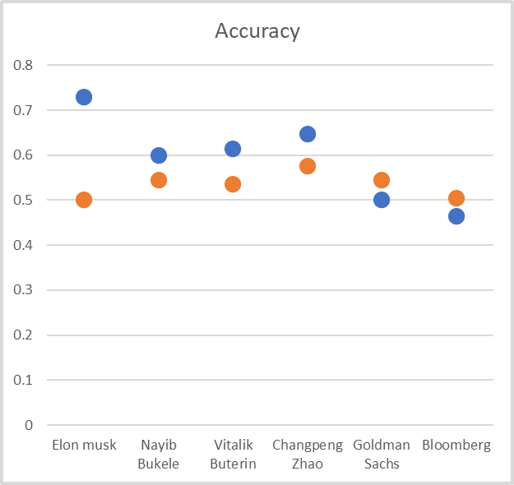
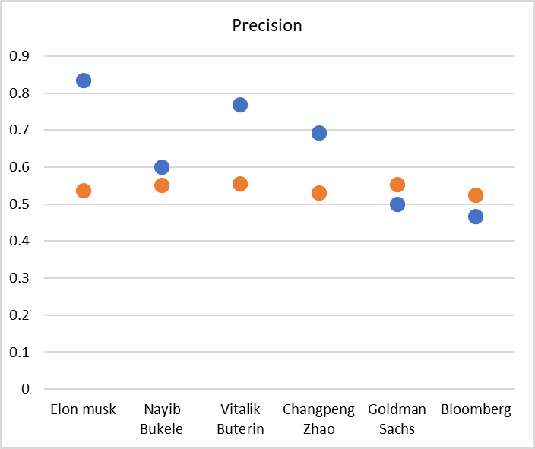
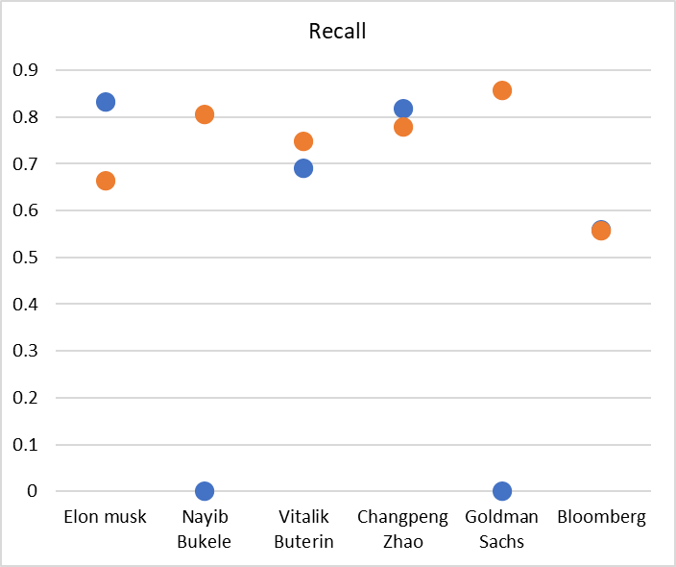
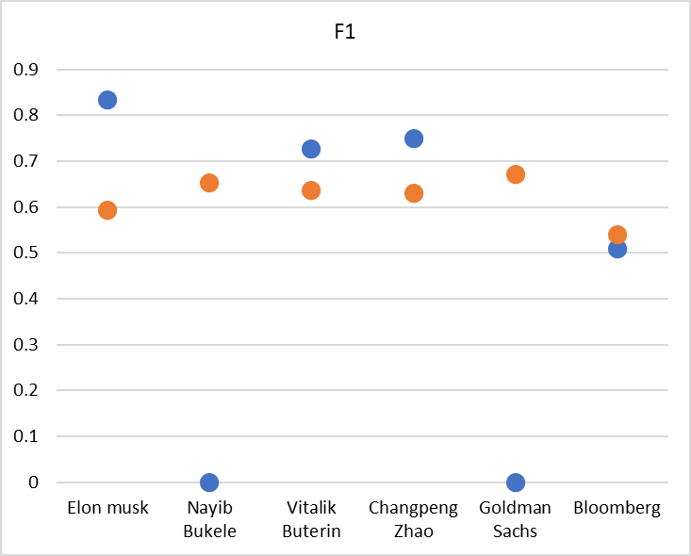
Hike/Dip
Confusion matrix
Rise/Drop
Generally, modelling based on hike or dip in price scored higher for accuracy and F1-scores.

Slide 19
Social Text Analysis (Compound Score w/ Confusion Matrix)
 | Overall compound score (Price Dip) | Overall compound score (Price Hike)
Vitalik Buterin | 0.99 | 0.96
Elon Musk | 0.77 | 0.99
Nayib Bukele | 0.82 | 0.92
Changpeng Zhao | -.10 | 0.99
Bloomberg | 0.99 | 0.98
Goldman Sachs | 0.80 | 0.81
During days of both price dips and price hikes, influencers’ tweets are generally very positive

Slide 20
What does this tell us?
There is better accuracy and F1-scores between sentiments of crypto-related tweets by influencers/institutions to explain large changes in Bitcoin price, as compared to non-significant Bitcoin price changes.

Slide 21
What does this tell us?
Influencers will still tweet positivity during days of large decrease, probably because of personal interest in the coin.

Slide 22
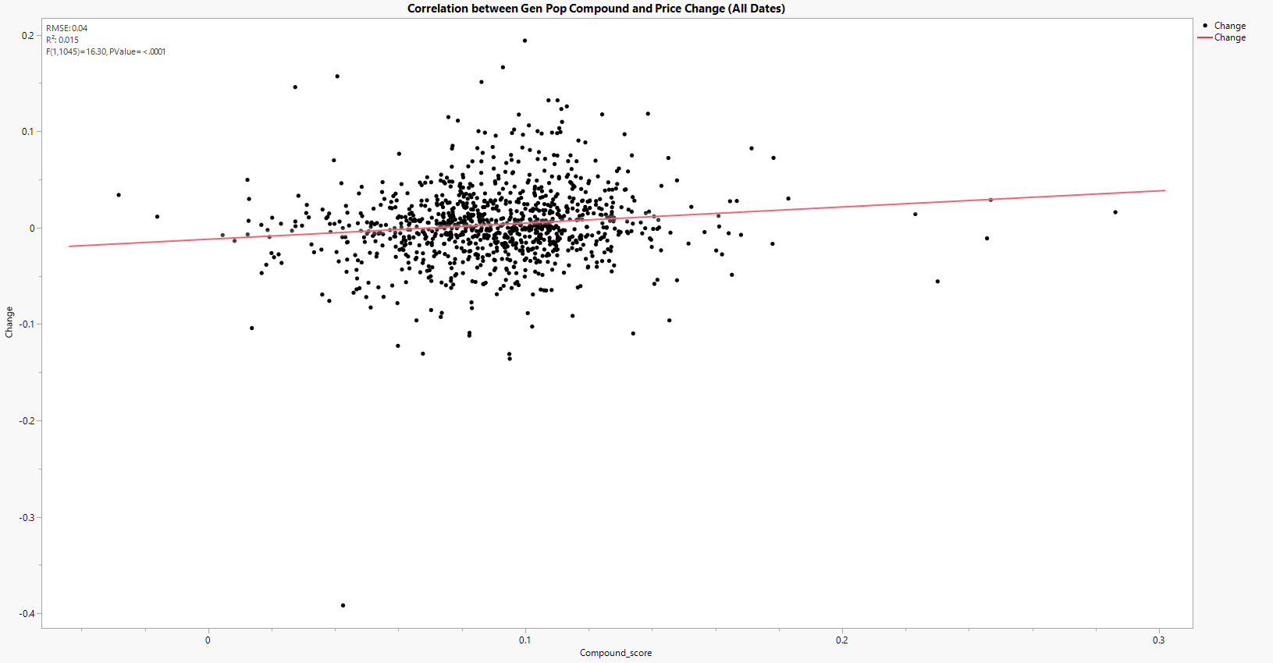
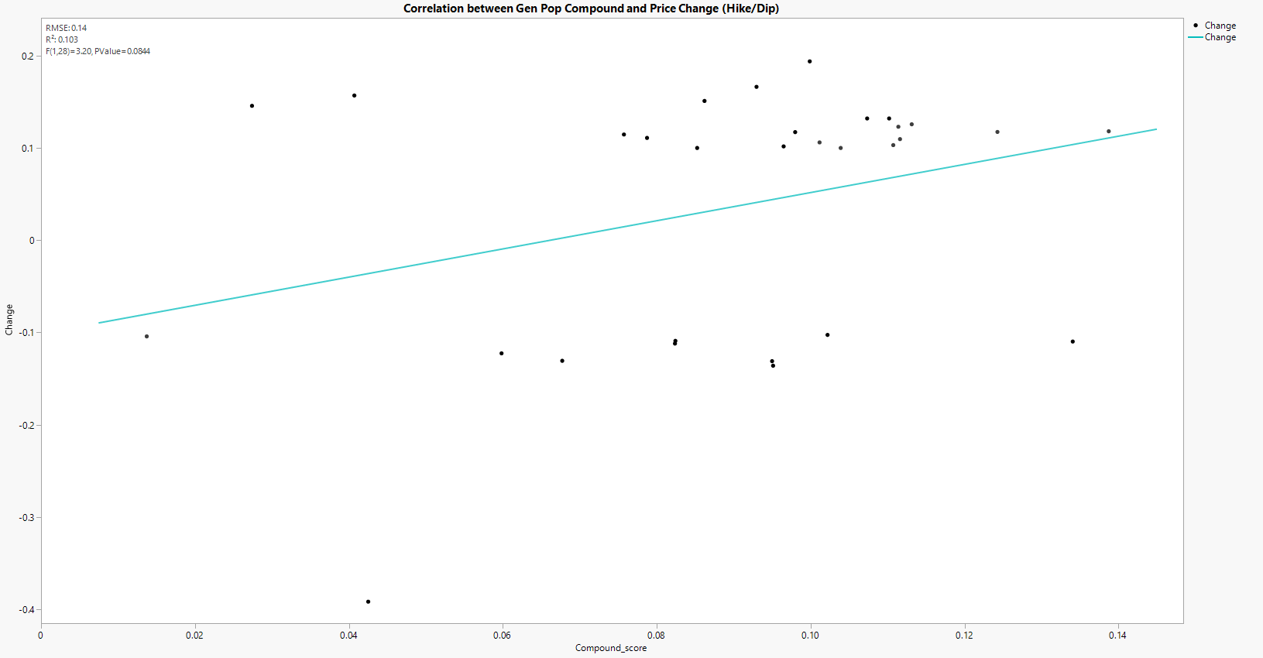
Twitter GenPop Insights
Hypothesis: “Prices of cryptocurrencies have a strong correlation with the sentiments of certain individuals, institutions or the general population”
GenPop
R² = 0.015
GenPop (Hike/Dip)
R² = 0.103
There is weak/no correlation between prices and the sentiments of twitter general population
Notes:
We not only do sentiment analysis on the tweets of influencer and institutions, but also Twitter General Population, basically the tweets about bitcoin from any twitter handler
In our project, the hypothesis is that price of crypto have strong correlation with the sentiment/ compound score.
However, both of the graphs shown here that the R-squared value for is very close to 0, meaning that there is weak/no correlation.
The different between left and right graph is that on the left graph, all tweets are included, while on the right, only tweets with large increase of decrease are included.

Slide 23
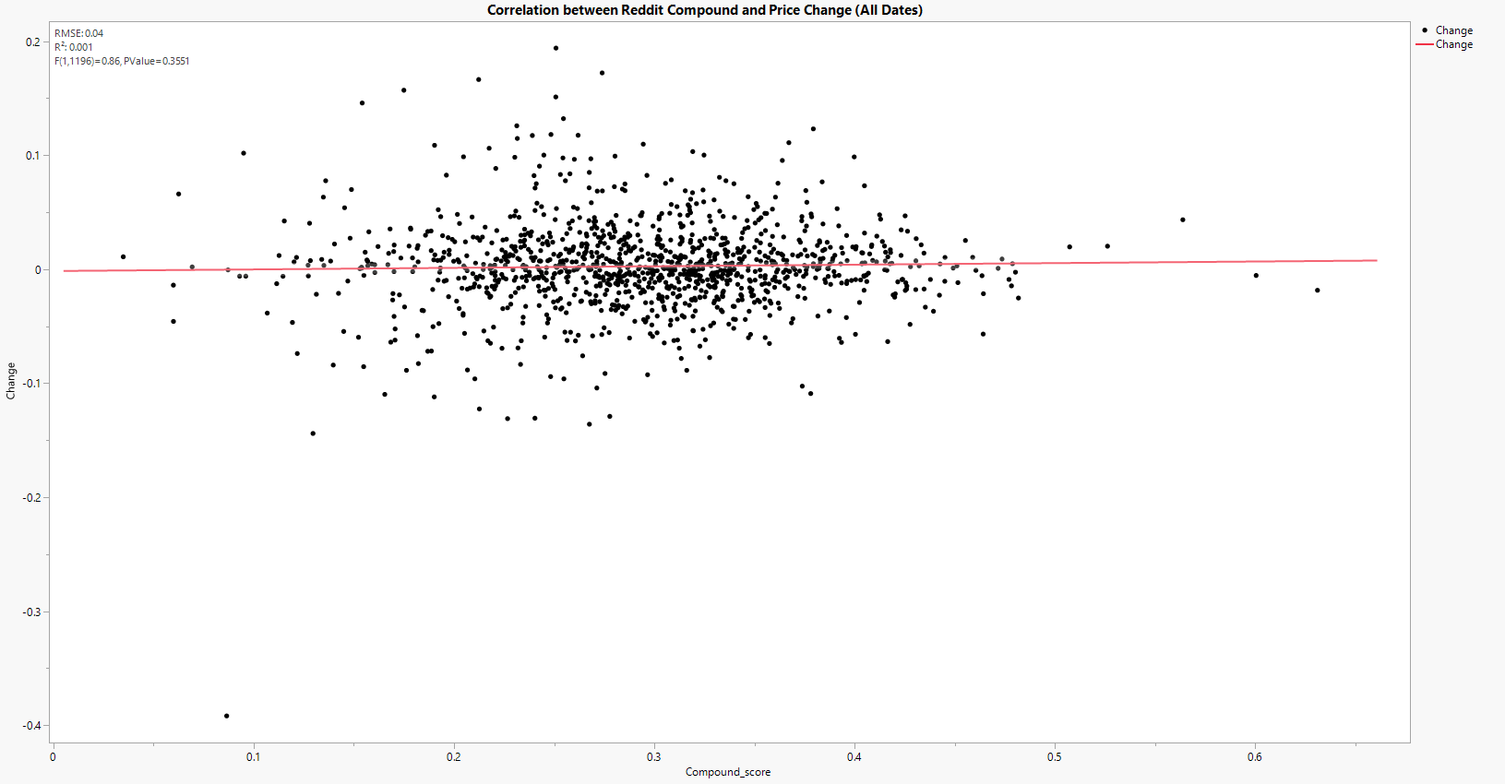
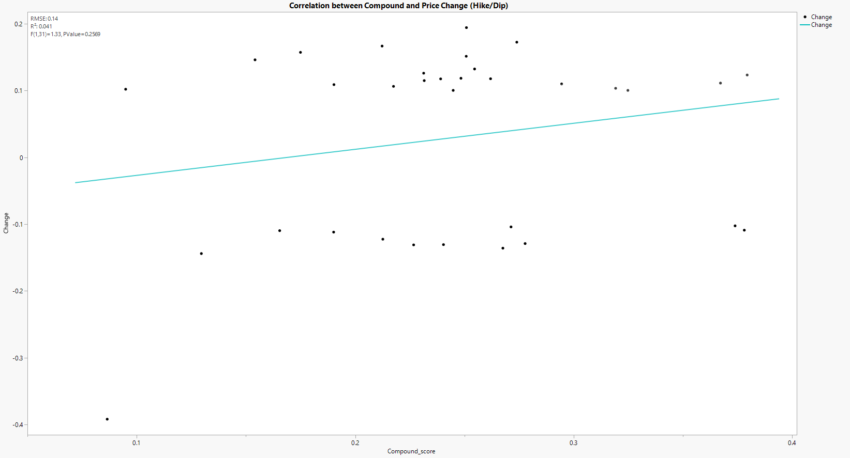
Reddit Insights
Hypothesis: “Prices of cryptocurrencies have a strong correlation with the sentiments of certain individuals, institutions or the general population”
GenPop
R² = 0.001
GenPop (Hike/Dip)
R² = 0.041
There is weak/no correlation between prices and the sentiments of reddit general population
Notes:
Next, is for the reddit post.
The r-squared value is also very close to 0 and so we can conclude that the price of crypto has weak correlation with the sentiment on both twitter general population and reddit posts.

Slide 24
04
Topic modelling
For Bitcoin
Notes:
Previously from our analysis on the sentiment of influencers/institutes , we found out that Influencers/institutions will still tweet positivity during days of large decrease.
So, we also do topic modelling from the influencer and institution tweets so that we can figure out what other things happening that might also affect the crypto price.

Slide 25
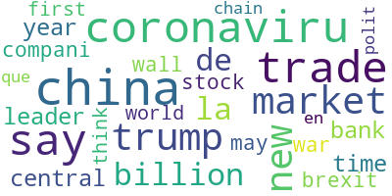
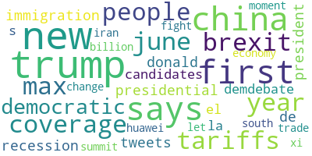
Topic Modeling [ Bitcoin days ]
High days
Low days
Topics revolve around
Geopolitics [Trump]
Markets and finance
Coronavirus
Topics similar to high days, with exception of
Xi Jin Ping
Recession
Tariffs
Economy

Slide 26
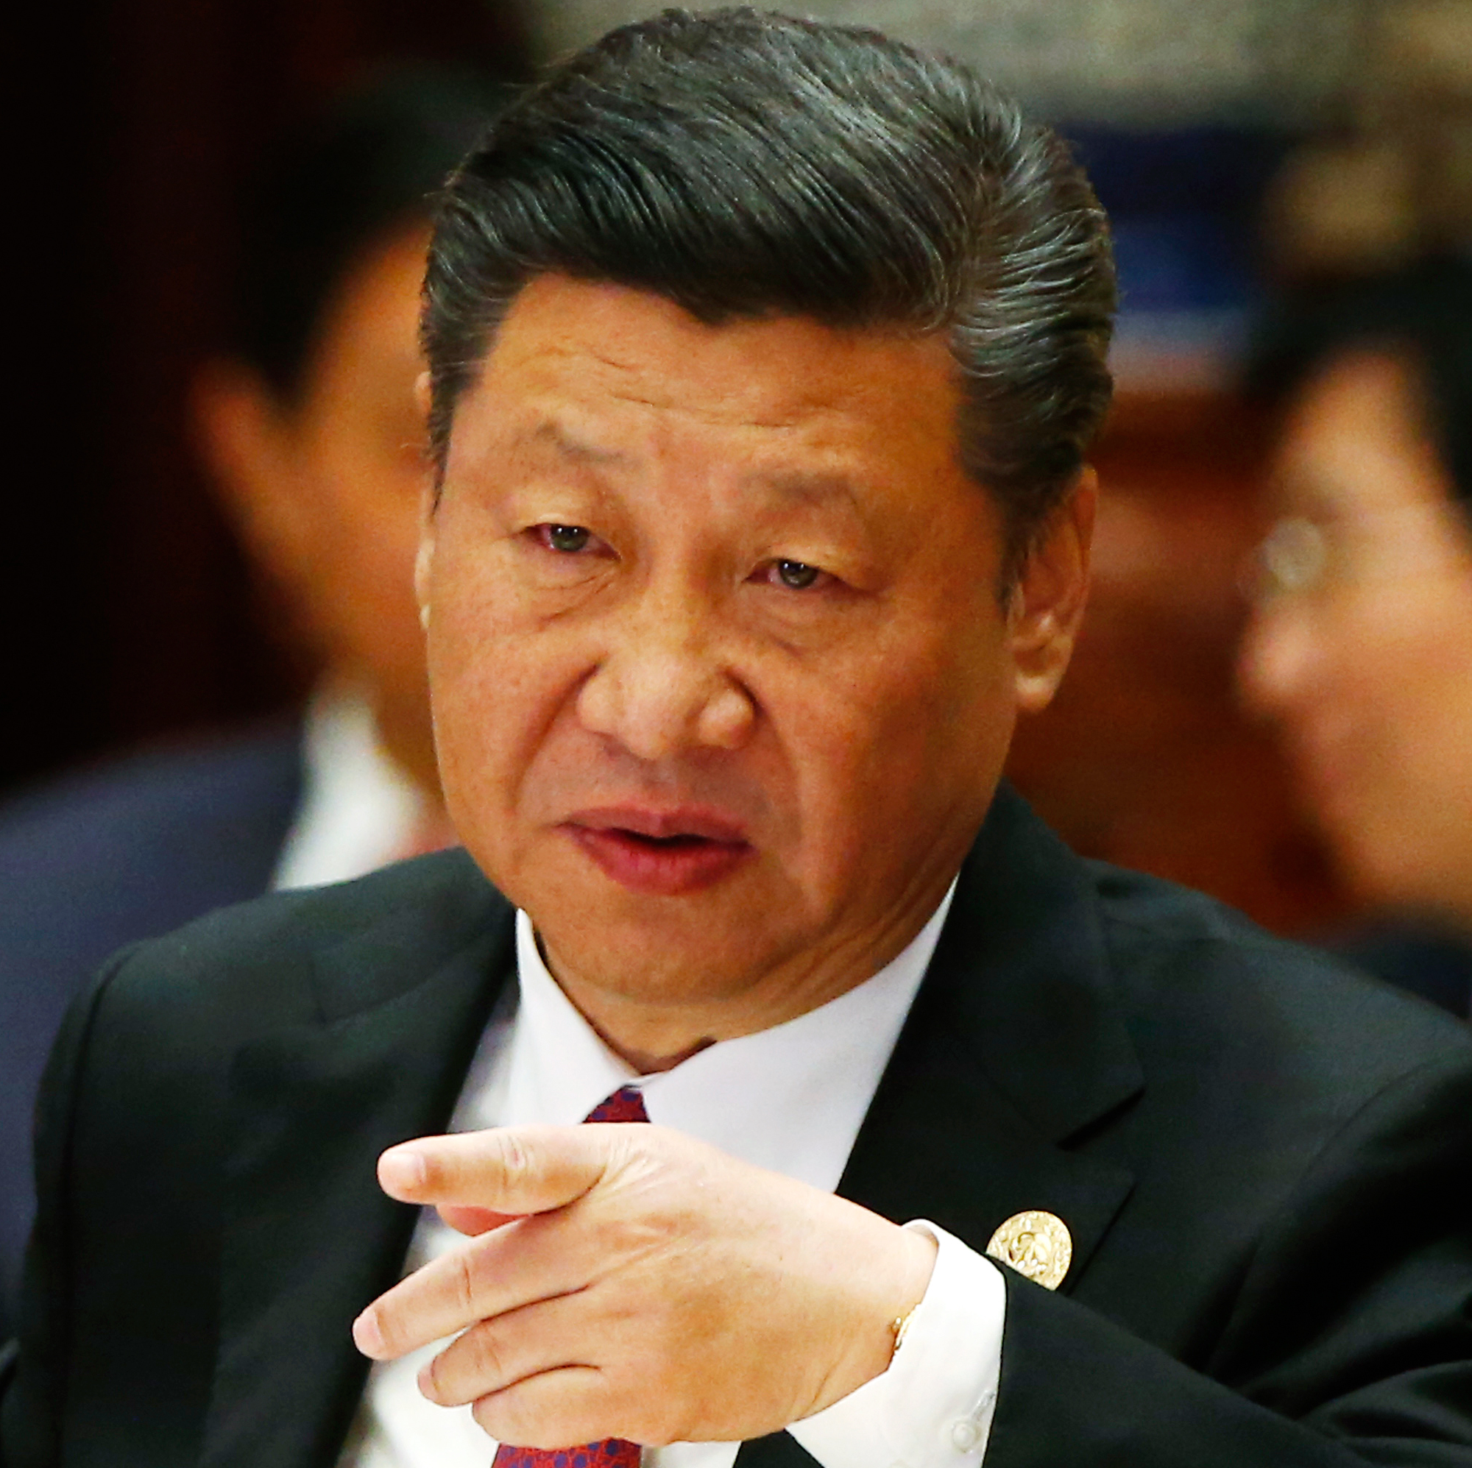
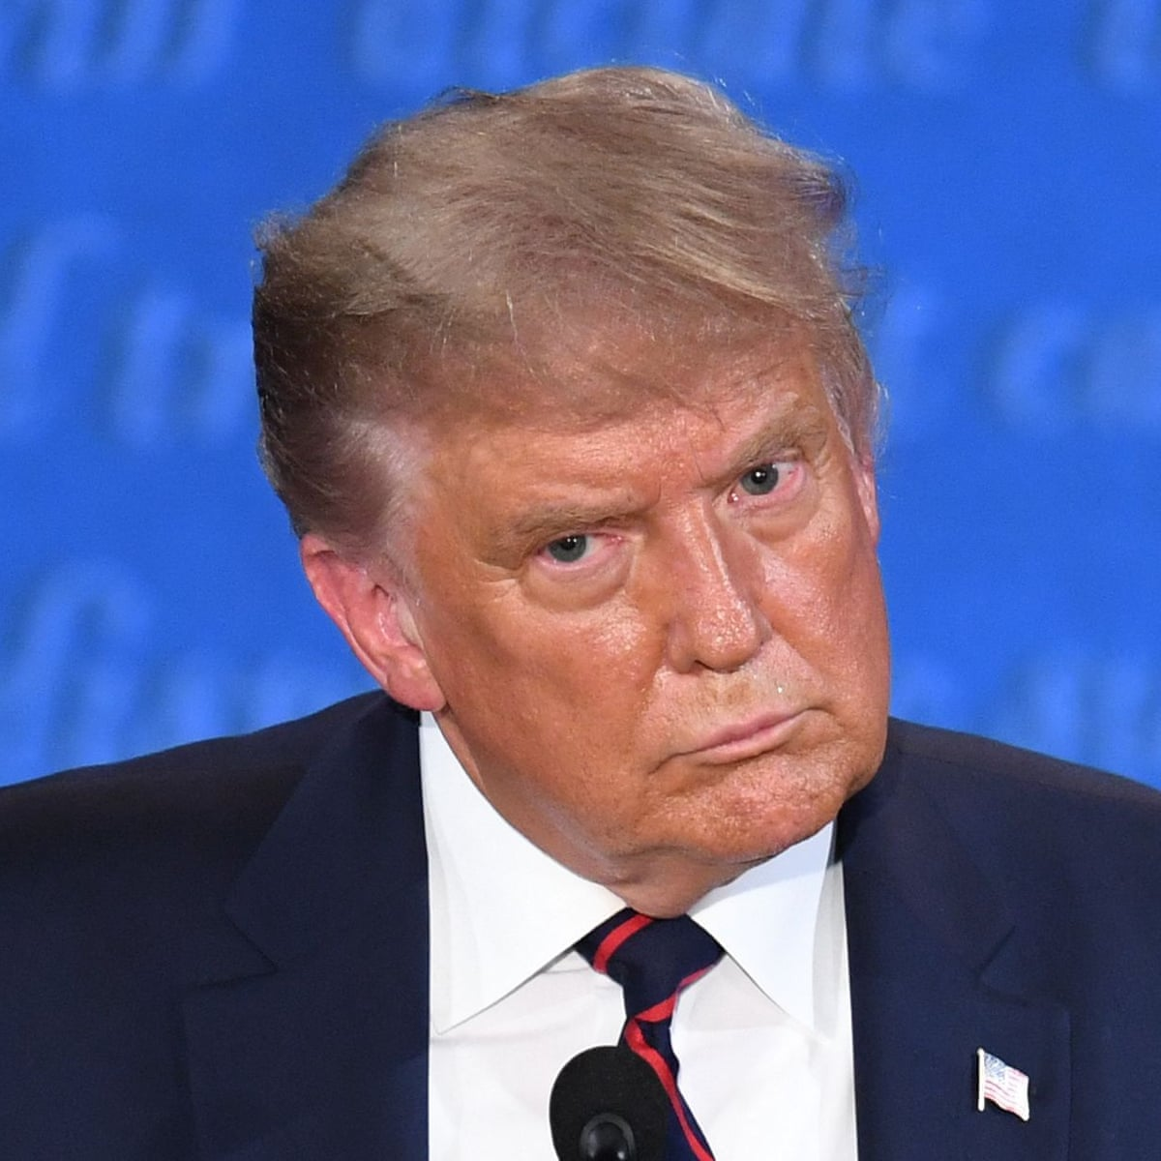
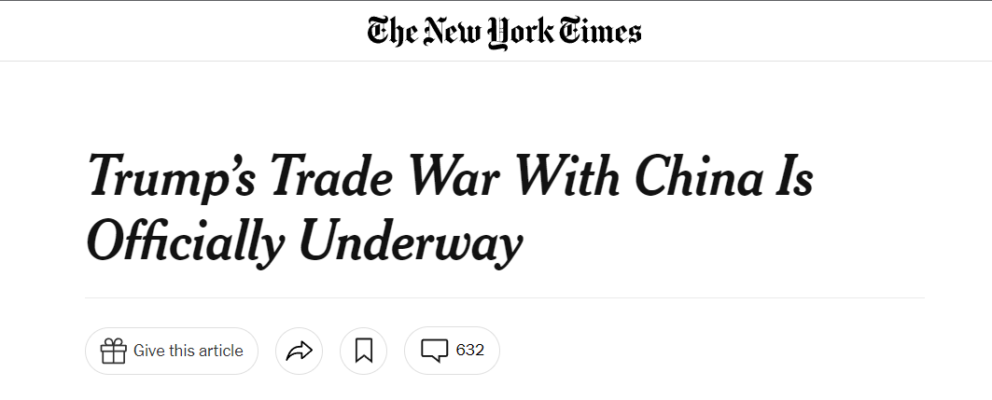
Trade war !
We can infer that crypto prices dropped significantly on days where news about trade war, tariffs, speculation about recession broke and spread to Twitter
Notes:
For the conclusion on our project, I will pass to Jordan.

Slide 27
05
Conclusion
Analysis and room for improvements

Slide 28
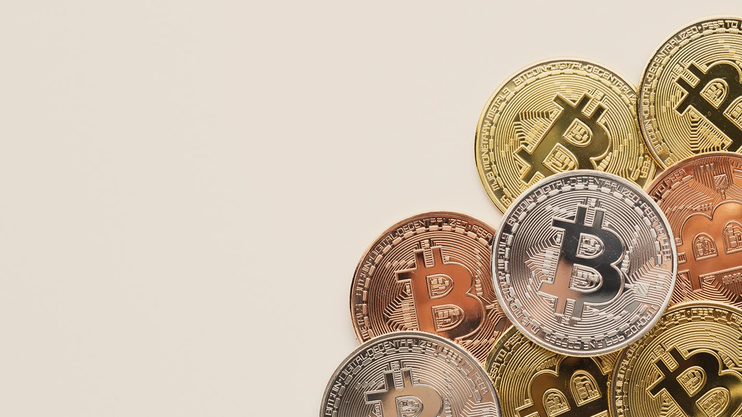
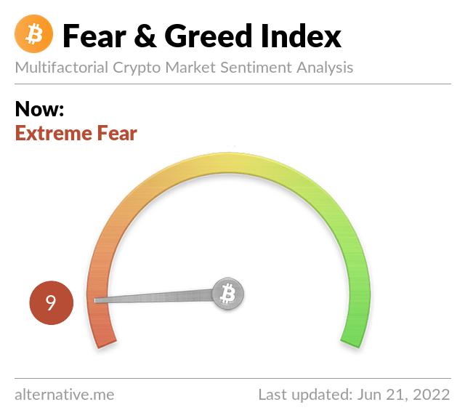

Analysis
Influencers and Institutions do not always affect price change of Bitcoin.
There is no correlation between general population sentiments and Bitcoin price change.
You can never be RICH just by analyzing tweets and reddit post to predict Bitcoin price change!
Notes:
To conclude, from our analysis we can conclude that influencers and institutions tweets do not always affect price change and the centrality score does not affect the individuals ability to affect price change. From the sentiment analysis, we can also see that for both social media application, the general population sentiments has no correlation to the price change of Bitcoin on a daily basis. Therefore, if you want to be rich, never ever use the sentiments of the population from these 2 social media application to drive your decision in trading/investing of Bitcoin!

Slide 29
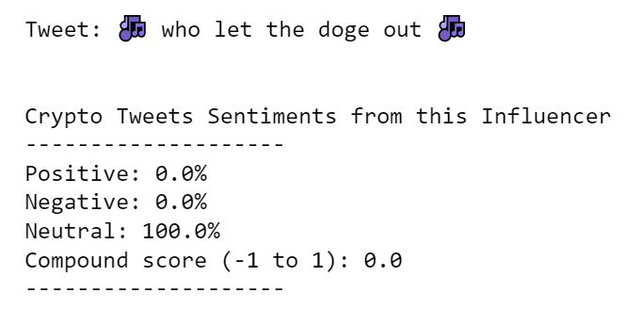
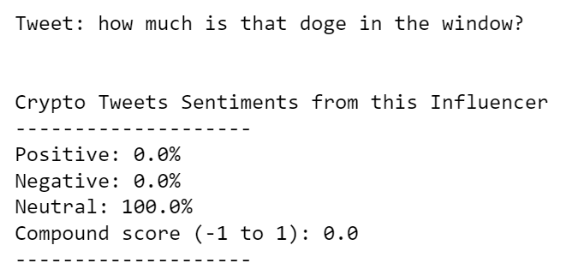
Room for improvements for sentiment analysis
Model does not understand context and meaning
Elon musk is hyping up Doge here = Very Positive

Slide 30
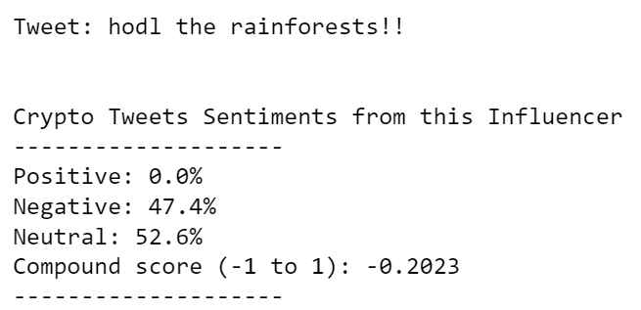
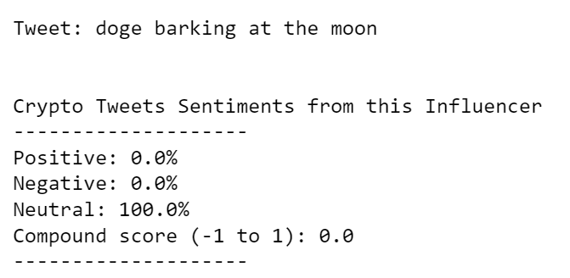
Room for improvements for sentiment analysis
Model does not understand community created acronyms, words and phrases
HODL stands for “Hold On For Dear Life”, which means to never sell your holdings
Doge barking to the moon implies a significant increase in price of Doge

Slide 31

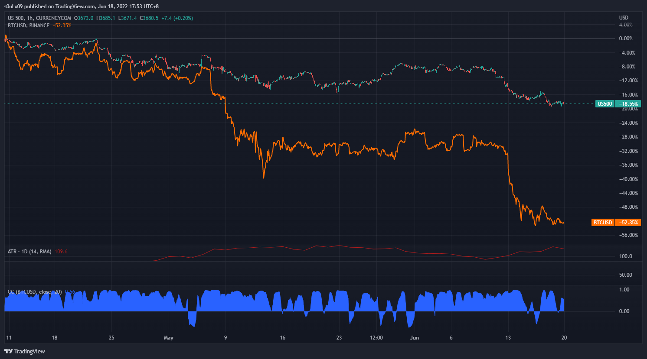
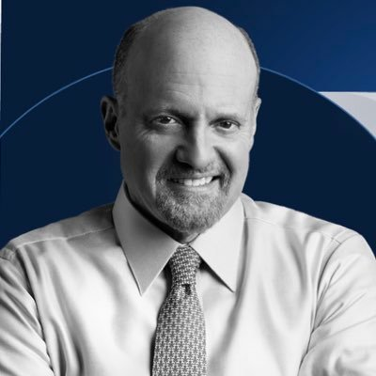

Room for improvements
Variety of Influencers and Institutions that have influence over the S&P 500
Jim Cramer
Correlation between the S&P 500 and BTCUSD
Fed Reserves
Influencers & Institutions

Slide 32


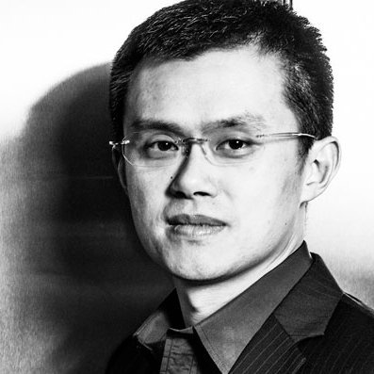
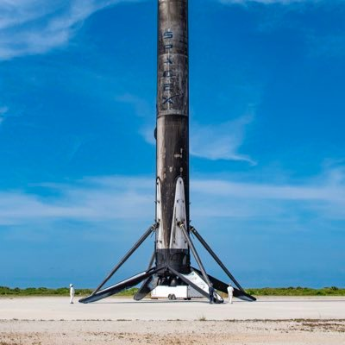
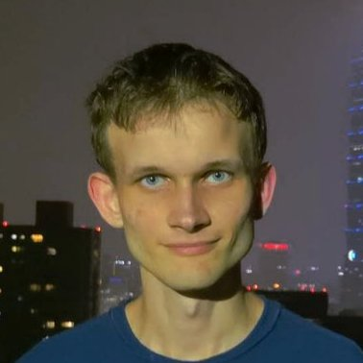
Room for improvements
Full Centrality Model for Influencers/Institution with high computational CPU
Influencers & Institutions

Slide 33
Thank You
Notes:
Why not indegree?
Cause the # is a parameter we set
Why not eigenvector?
Cause it’s a directed graph
Why PageRank?
Twitter alot of fake accounts / bot accounts which we wanna reduce their importance
Why only followers?
Our objective is to know how they influence their followers

Slide 34
ANNEX

Slide 35
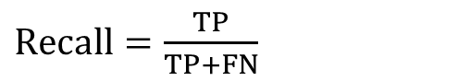
Influence Scoring (Bitcoin – Hike(Rise)/Dip(Drop))
$Recall=\frac{TP}{TP+FN}$
Elon Musk
Actual Label = 0 |  | Actual Label = 1
Dip | Drop | Hike | Rise
1 | 24 | 2 | 33
2 | 56 | 10 | 65
Changpeng Zhao
Actual Label = 0 |  | Actual Label = 1
Dip | Drop | Hike | Rise
2 | 62 | 2 | 72
4 | 222 | 9 | 252
Bloomberg
Actual Label = 0 |  | Actual Label = 1
Dip | Drop | Hike | Rise
70 | 2295 | 82 | 2492
119 | 2854 | 104 | 3138
Predicted Class = 0 (-ve Compound Score)
Predicted Class = 1 (+ve Compound Score)
Nayib Bukele
Actual Label = 0 |  | Actual Label = 1
Dip | Drop | Hike | Rise
0 | 9 | 0 | 8
2 | 27 | 3 | 33
Vitalik Buterin
Actual Label = 0 |  | Actual Label = 1
Dip | Drop | Hike | Rise
4 | 174 | 9 | 185
6 | 440 | 20 | 548
Goldman Sachs
Actual Label = 0 |  | Actual Label = 1
Dip | Drop | Hike | Rise
0 | 8 | 0 | 8
1 | 39 | 1 | 48
Predicted Class = 0 (-ve Compound Score)
Predicted Class = 1 (+ve Compound Score)

Slide 36
Network Centrality Analysis
Normalised PageRank
Level 0
Level 1
Level 2
Results
4 influencer + 2 institutes
5000 followers from each Level 0 users
5000 followers from each of the top 10% Level 1 users
PageRank is calculated based on a ~180,000-node network, normalised by sum of all scores
PageRank Scoring
No. of Followers
Influencers: Institutions:
High follower count ≠ High PageRank Score
Changpeng’s PageRank score is similar to Elon Musk’s despite having only 10% of the follower count
Elon Musk | ~ 98,000,000
Changpeng Zhao | ~ 6,400,000
Vitalik Buterin | ~ 4,000,000
Nayib Bukele | ~ 4,000,000
Bloomberg | ~ 8,300,000
Goldman Sachs | ~ 937,700
Observation:
Influencers
Institutions
Size = # of followers
Notes:
ADD IN LIMITATION (5000 SAMPLE SIZE)
No effect on accuracy / precision
Peace – Centrality Analysis

Slide 37
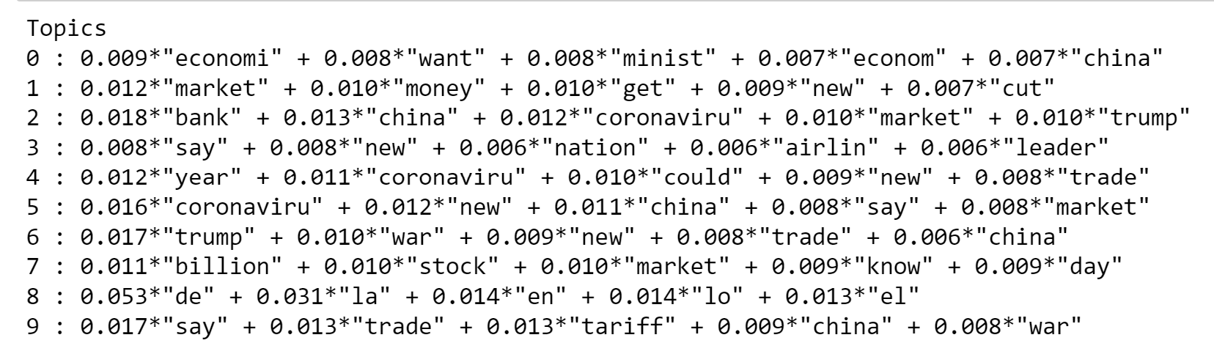
Topic Modelling data
Topic distribution for some documents

Slide 38
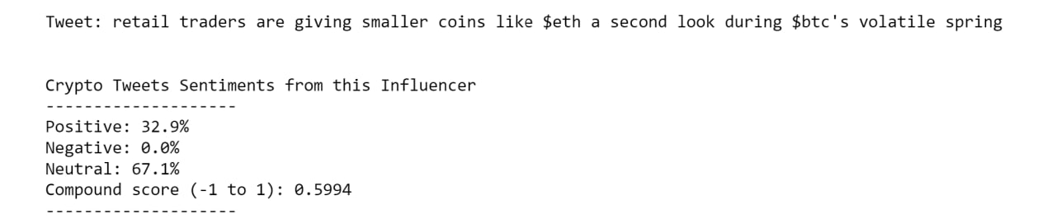
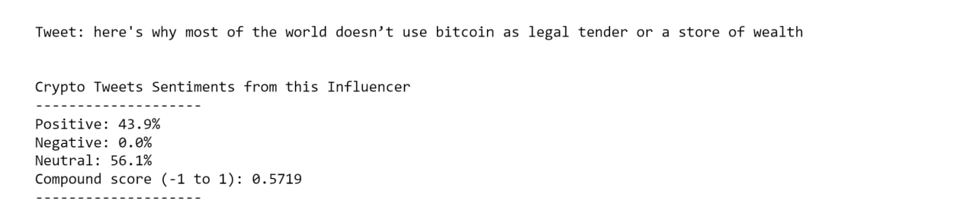
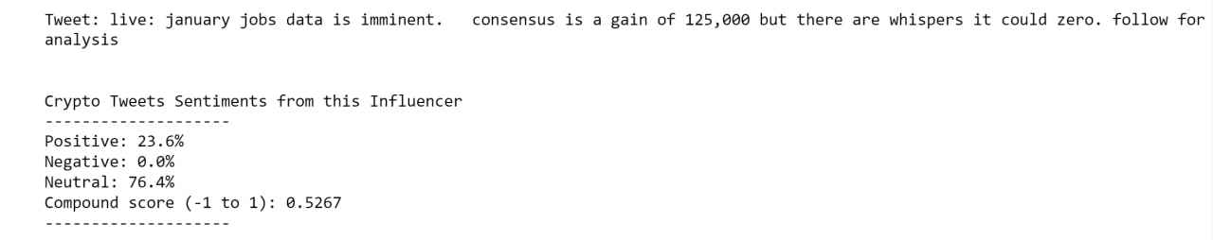
Bloomberg’s Tweets
During days when price of bitcoin dropped, bloomberg still have positive tweets related to other topics, because it is a news network
Low Days
High Days

Slide 39
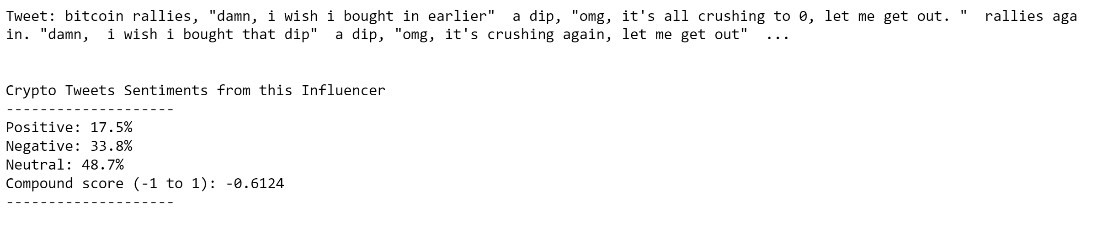
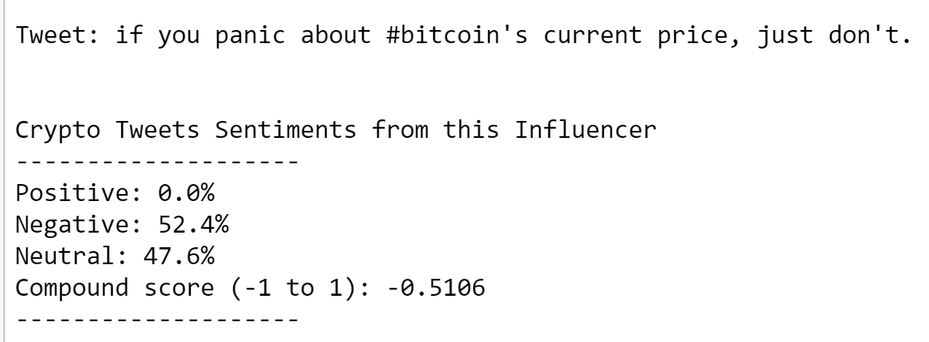
CZ_Binance Tweets during dip days
CZ_Binance tweets are sarcastic, which model cannot compute accurately.
Model also cannot pick up context

